Slide 1
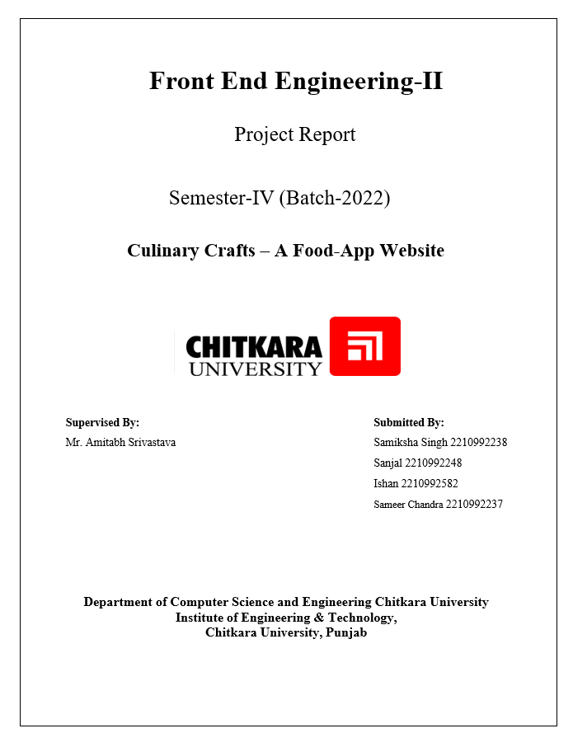

Slide 2
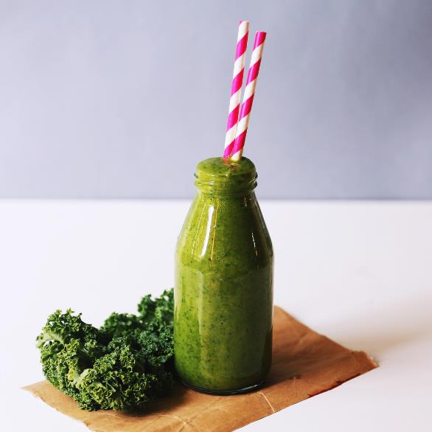
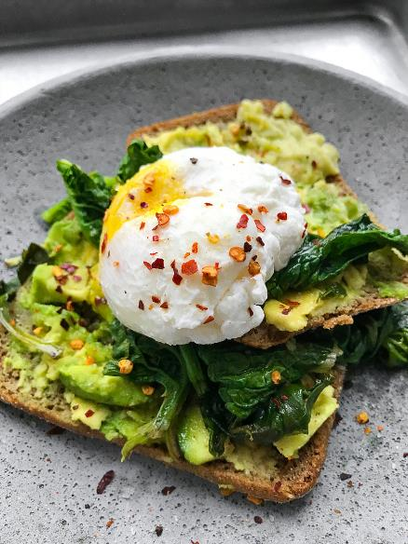
NEED OF THE PROJECT?
In today's digital age, more people are turning to cooking as a creative outlet and a way to connect with others with similar tastes.
However, the abundance of recipes scattered across the internet, the challenge of organizing ingredients, and the desire for community-driven experiences inspired us to create CulinaryCrafts.

Slide 3
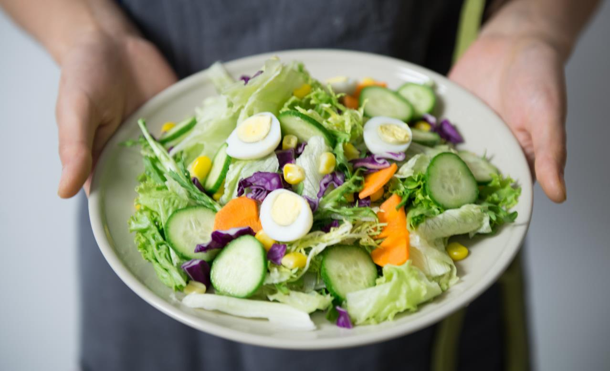
WHAT IS CULINARY
CRAFTS?
Our website is meticulously crafted to simplify every step of your culinary adventure, catering to both seasoned chefs and kitchen novices alike.
Whether you're an experienced cook looking for inspiration or someone just starting out, CulinaryCrafts can become your best companion in the kitchen.

Slide 4
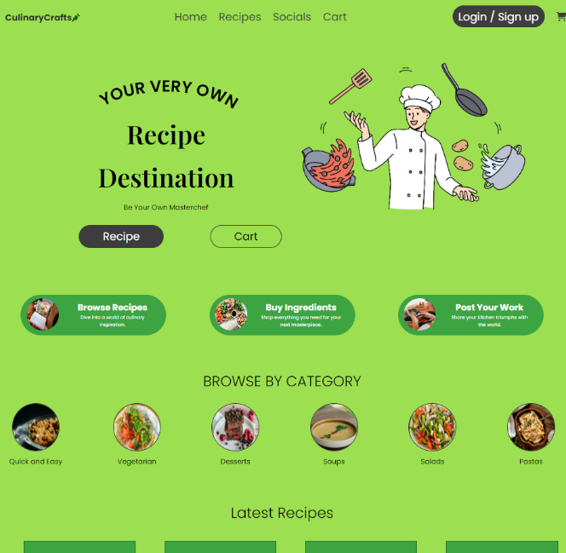
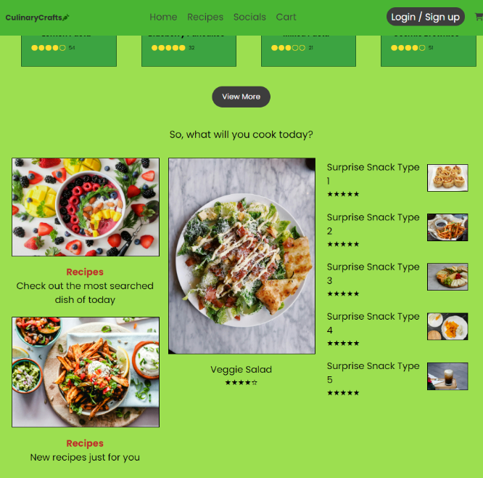
HOME SECTION

Slide 5
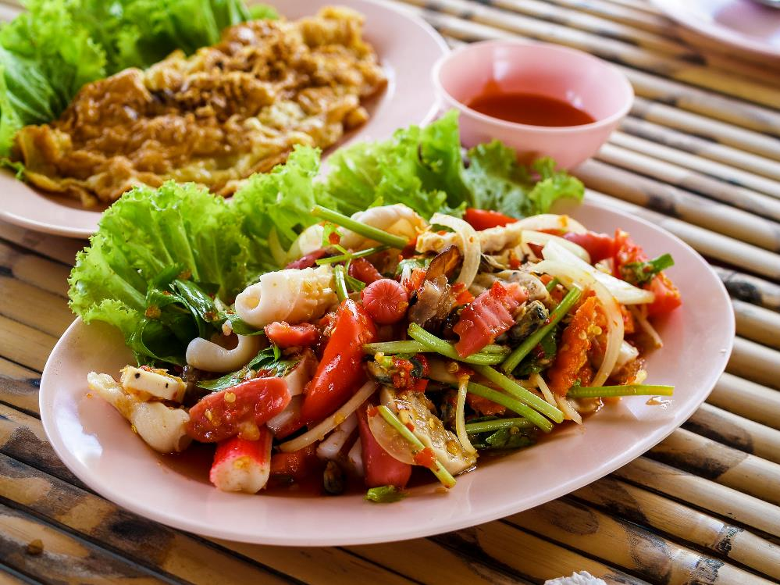
SOCIAL
It doesn’t matter whether you are an experienced cook or a foodie who is looking for something, you can share your culinary triumphs, swap your kitchen stories, connect with other foodies across all culture and places. We bring you a place where you can connect with diverse range of people of similar interest.

Slide 6
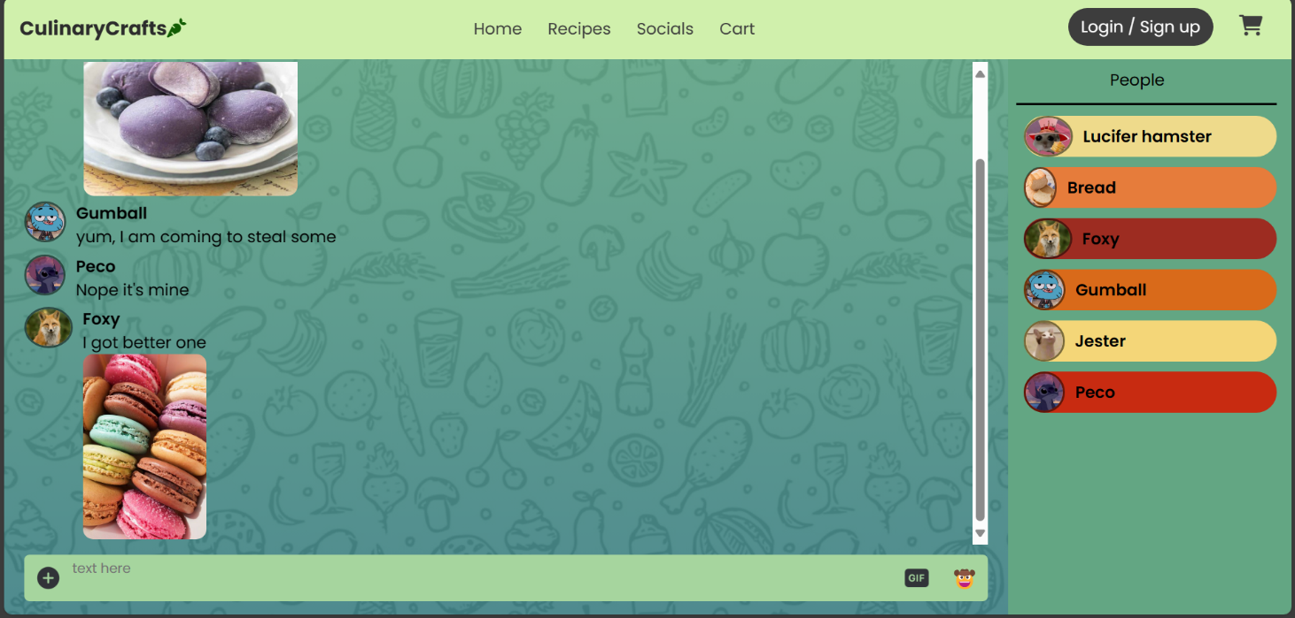
SOCIAL SECTION

Slide 7
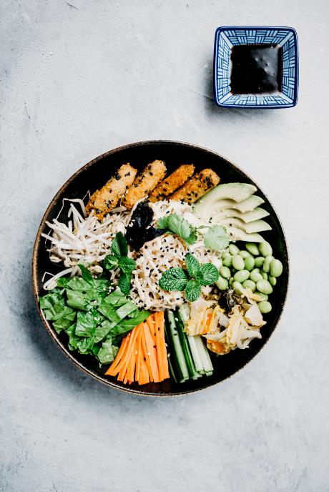
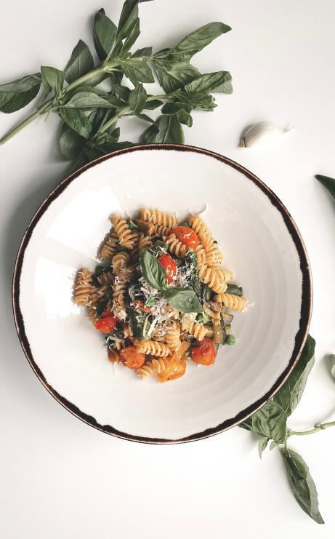
RECIPES
In the age of information, where there are countless recipes, recommendations of experts, we bring you a treasure trove of recipes curated from the finest corner of the world where you can have a taste of culture whose authentication is personally verified by us or by the community itself.

Slide 8
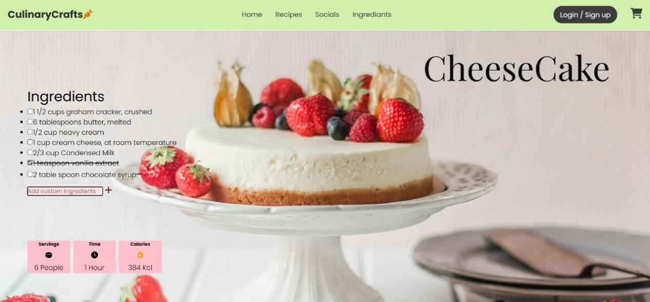
RECIPE SECTION

Slide 9
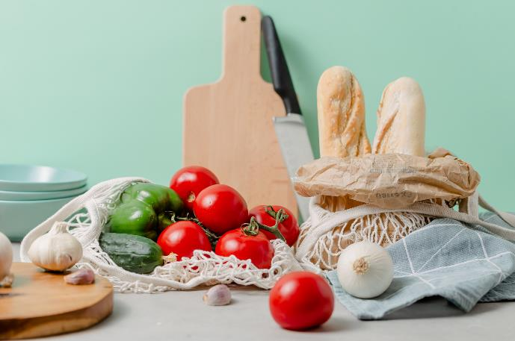
INGREDIENTS
Now you don’t need to search for specific ingredient mentioned in our recipe across several markets and still worry about quality. With this you are guaranteed to get only that ingredient in good quality just outside your doorstop.

Slide 10
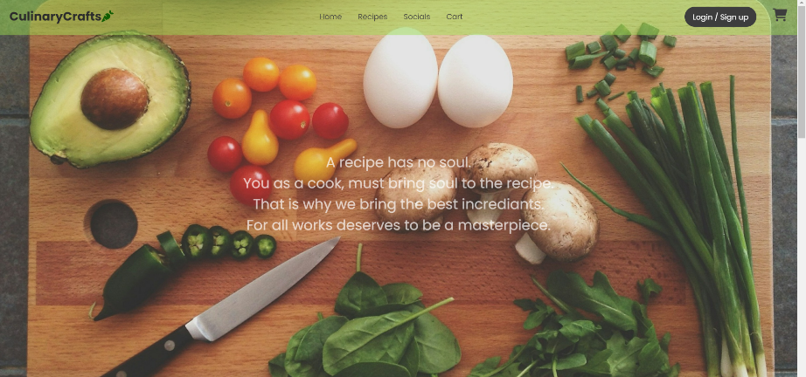
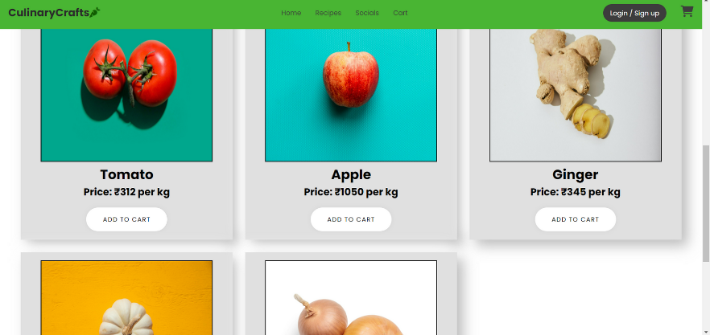
INGREDIENT SECTION

Slide 11
TECHNOLOGICAL FOUNDATIONS
Built using HTML, CSS and React.js for a responsive and intuitive user interface.
Utilizes local storage to securely store user information and preferences.
Integration of external libraries such as:
React Router: Facilitates client-side routing for seamless navigation between pages and components.
Context API (Shop Context Provider): Manages global state and facilitates data sharing between components.
useState and useEffect Hooks: Enables state management and handling of side effects within functional components.
CSS Modules: Utilized for scoped styling, ensuring encapsulation and preventing style conflicts.
React Context (Shop Context): Provides a centralized approach to state management, reducing prop drilling and enhancing scalability.
React Hooks (useContext): Allows functional components to consume context, simplifying state management and component interactions.

Slide 12
FUNCTIONS
Main Page: Upon opening the website, users are greeted with a visually appealing main page featuring quick access to various sections.
Social Page: Engage with a vibrant community of cooking enthusiasts, share recipes, leave comments, and discover new culinary inspirations.
Cart Page: Seamlessly organize and manage your shopping list, add ingredients to your cart, and proceed with secure checkout.
Recipe Page: Explore a diverse collection of recipes categorized by type, cuisine, and dietary preferences, with detailed instructions and ingredient lists.
Login Page: Create an account or log in to unlock personalized features, recipes, and access exclusive content.

Slide 13
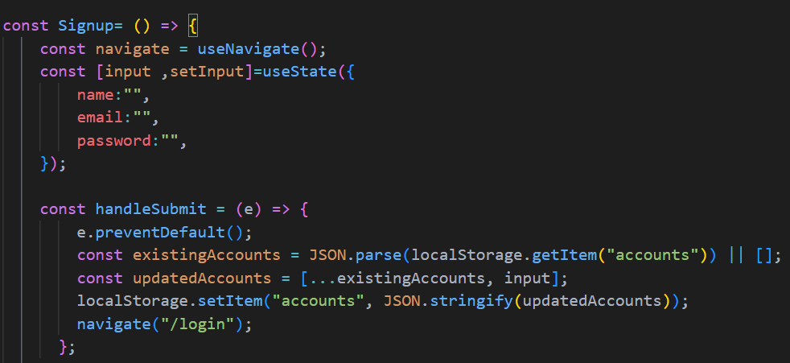
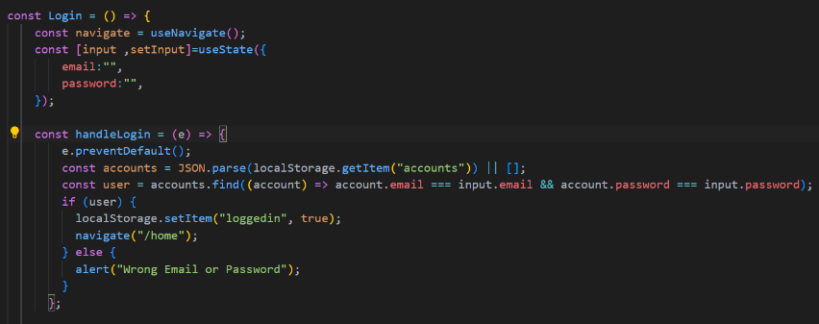
HOW IT WORKS?
LOGIN
Signup Process: Users fill out a form on the signup page with their name, email, and password. Upon submission, their information is stored locally as a new user account. After successful signup, users are directed to the login page.
Login Process: Users input their email and password on the login page. The application checks the entered credentials against locally stored user accounts. If the credentials match, users are authenticated and redirected to the home page. If there's an error (incorrect credentials), users are alerted.

Slide 14
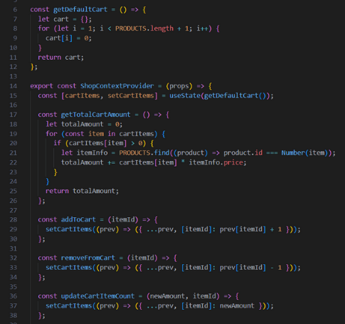
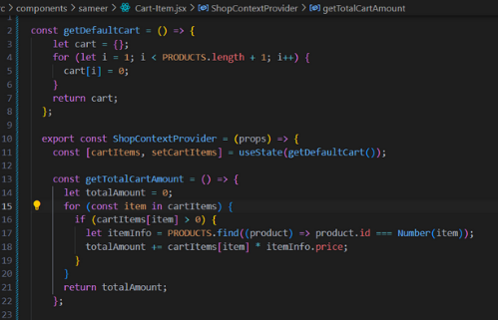
CART
Initializing the Cart: The cart is initialized with default quantities for each product. This is achieved through the getDefaultCart function.
Cart Context Provider: The ShopContextProvider component manages the state of the cart using React's useState hook. It also provides various functions to manipulate the cart state such as addToCart, removeFromCart, updateCartItemCount, and checkout.
Total Cart Amount Calculation: The getTotalCartAmount function calculates the total amount of the items in the cart by multiplying the quantity of each item by its price and summing them up.
Adding Items to the Cart: The addToCart function increments the quantity of a specific item in the cart.
Removing Items from the Cart: The removeFromCart function decrements the quantity of a specific item in the cart.
Updating Item Count: The updateCartItemCount function allows users to directly set the quantity of a specific item in the cart.
Checkout: The checkout function resets the cart to its default state, effectively emptying it.

Slide 15
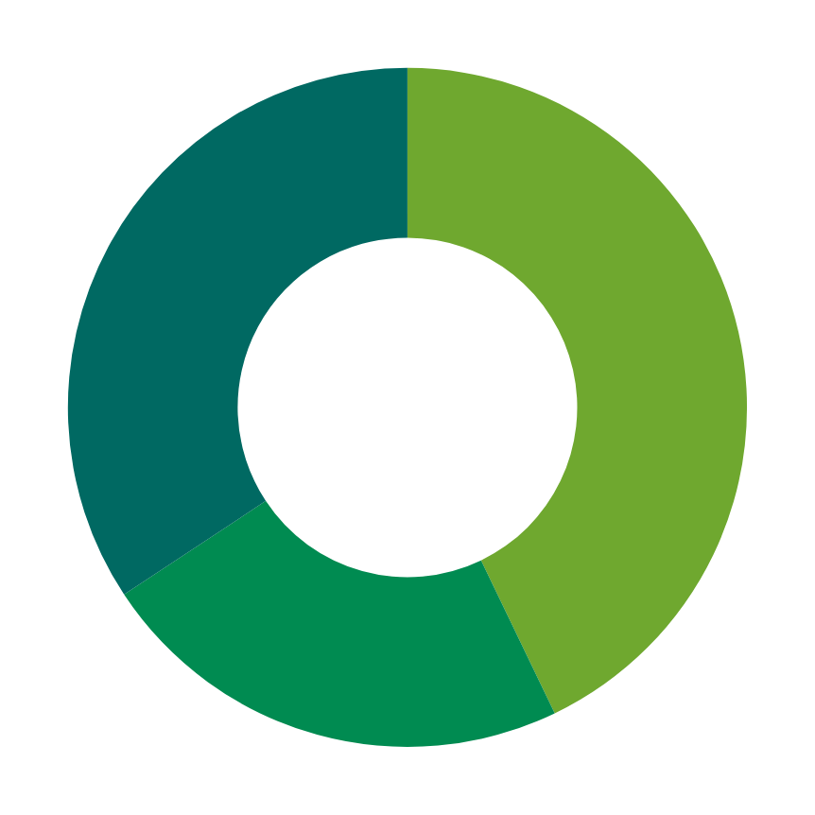
OUR GOALS
We aim to build a community where people can help each other, where people with similar hobbies share their joys of food, where a good recipe will never be buried because of lack of platform.

Slide 16



THANK YOU

